Slide 1
✔ Business Problem
In recent years, both the City Hotel and the Resort Hotel have experienced significantly high reservation cancellation rates. These cancellations have directly impacted revenue generation and room utilization, resulting in financial losses and operational inefficiencies.
To improve profitability and ensure optimal room occupancy, both hotels aim to reduce cancellation rates by understanding the key factors that influence guests’ booking behavior. This report focuses on analyzing the major drivers behind hotel reservation cancellations and identifying strategies that can support the hotels in improving revenue management, forecasting accuracy, and operational planning.

Slide 2
✔ Research Questions
1.What key variables influence hotel reservation cancellations?
2.How can hotels reduce and effectively manage reservation cancellations?
3.How can data-driven insights support hotels in making better pricing, promotional, and capacity-planning decisions?

Slide 3
✔ Assumptions
No unusual events between 2015 and 2017 significantly impacted customer booking behavior or hotel operations.
The dataset accurately reflects current hotel trends and can be used to develop reliable business recommendations.
The suggested solutions will not create unintended negative impacts on hotel operations or customer experience.
Hotels have not yet implemented the recommended strategies or optimization techniques included in this analysis.

Slide 4
Hypothesis
1.Higher room prices are associated with increased reservation cancellations.
2.Longer waiting lists increase the likelihood of customers cancelling their reservations.
3.A majority of bookings—and cancellations—originate from offline travel agencies.

Slide 5
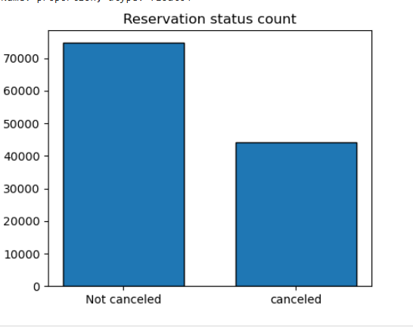
Analysis and Findings

Slide 6
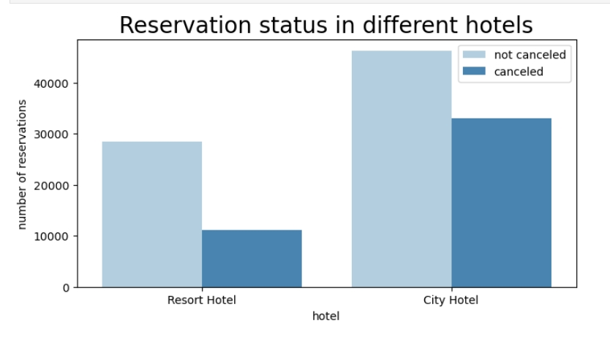
The accompanying bar graph shows the percentage of reservations that are canceled and those that are not. It is obvious that There are still a significant number of reservations that have not been canceled. There are still a significant number of reservations that are not been canceled. There are still 37% of clients who canceled their reservation, which has a significant Impact on the hotels’ earnings.

Slide 7
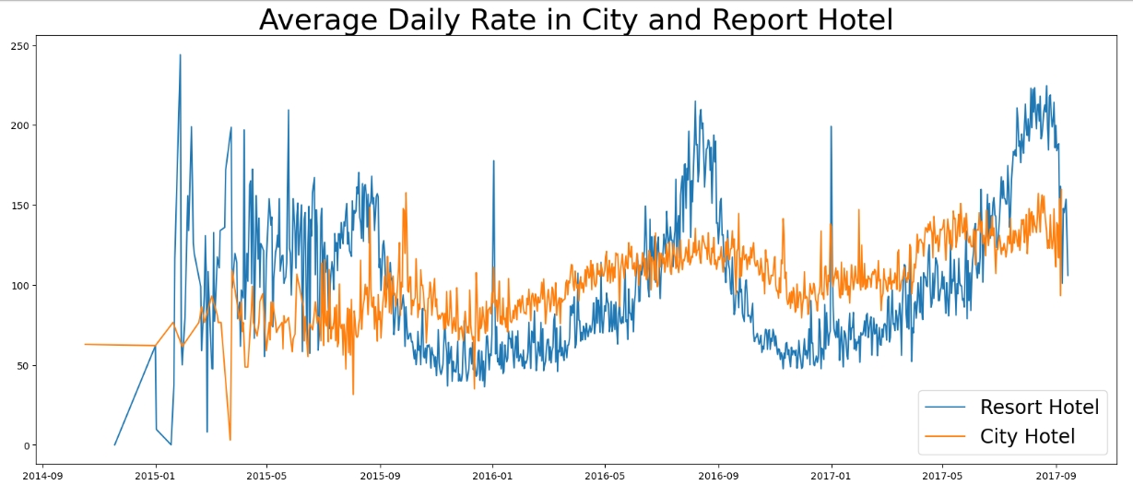
In comparison to resort hotels, city hotels have more bookings. It’s possible that resort hotels are more expensive than those in cities.

Slide 8
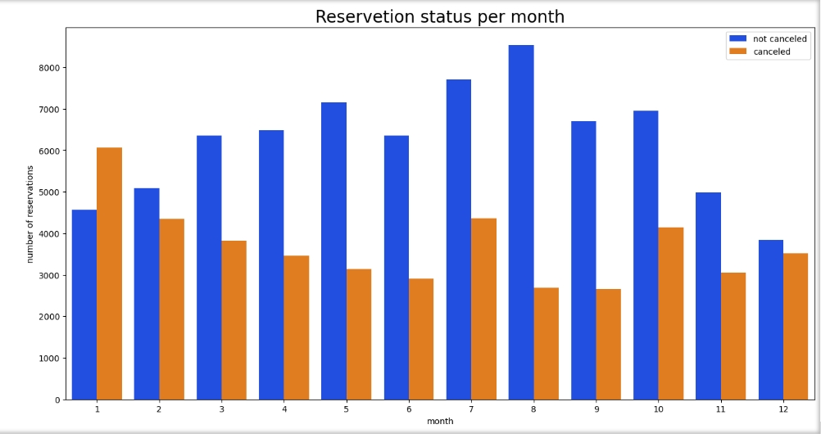
The Line graph above shows that, on certain days, the average daily rate for a city hotel is less than of a city hotel is less than that of a resort hotel, and on other days, it is even less, It goes without saying that weekends and holidays may see a rise in resort hotel rates.

Slide 9
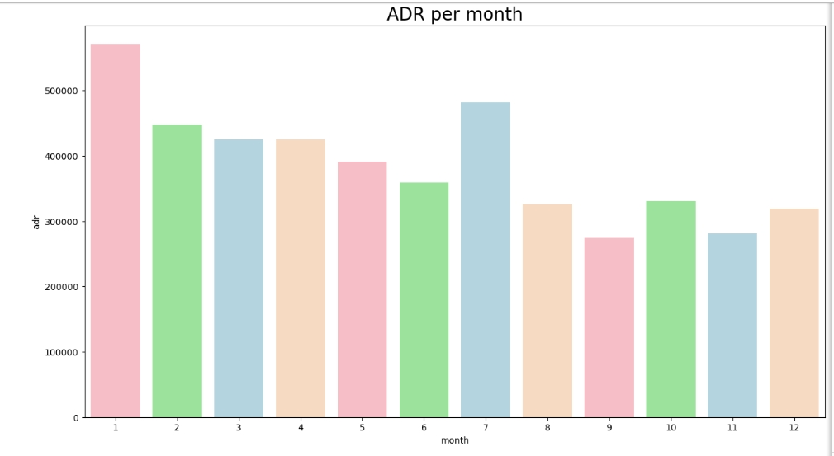
We have developed the grouped bar graph to analyze the months with the highest and lowest reservation levels according to reservation status. As can be seen, both the number of confirmed reservations and the number of canceled reservations are largest in the month of August. Whereas January is the month with the most canceled reservations.

Slide 10
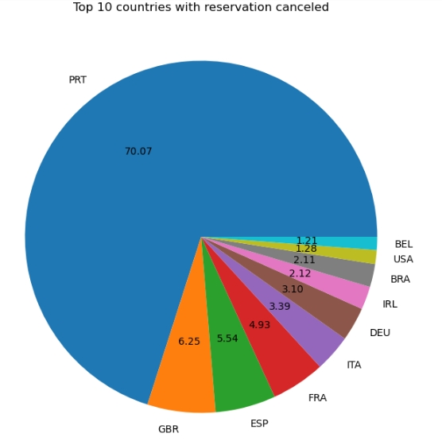
This bar graph demonstrates that cancellations are most common when prices are greatest and least common when they are lowest. Therefore, the cost of the accommodation is solely responsible for the cancellation.
Now, let’s see which country has the highest reservation canceled. The top country is Portugal with the highest number of cancellations.

Slide 11
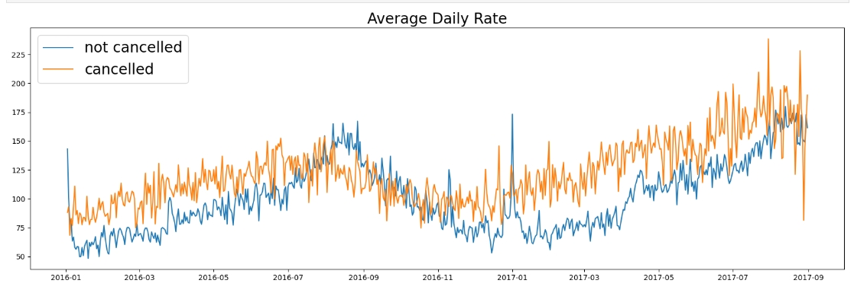
Let’s check the area from where guests are visiting the hotel and making reservations. Is it coming from Direct or Groups, Online or Offline Travel Agents? Around 46% of the clients come from online travel agencies, whereas 27% come from groups. Only 4% of clients book hotels directly by visiting them and making reservations.
As seen in the graph, reservations are canceled when the average daily rate is higher than when it is not canceled. It clearly proves all the above analysis, that the higher price leads to higher cancellation.

Slide 12
Suggestions
Cancellation rate rise as the price does. In order to prevent cancellations of reservations, hotels could work on their pricing strategies and try to lower the rates for specific hotel based on locations. They can also provide some discounts to the consumers.
As the ratio of the cancellation and not cancellation of the resort hotel is higher in the resort hotel than the city hotels. So the hotels should provide a reasonable discount on the room prices on weekends or on holidays.
In the month of January, hotels can start campaigns or marketing with a reasonable amount to increase their revenue as the cancellation is the highest in this month.
They can also increase the quality of their hotels and their services mainly in Portugal to reduce the cancellation rate.

